Slide 1
區塊鏈原理與應用
陳君明 Jimmy Chen
jmchen@crypto.tw
2016. 11. 29

Slide 2
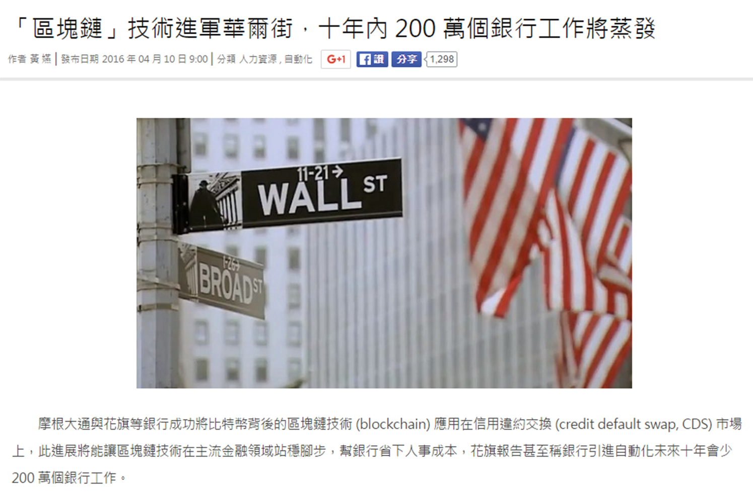
關於講題
http://technews.tw/2016/04/10/blockchain-applied-on-wall-street

Slide 3
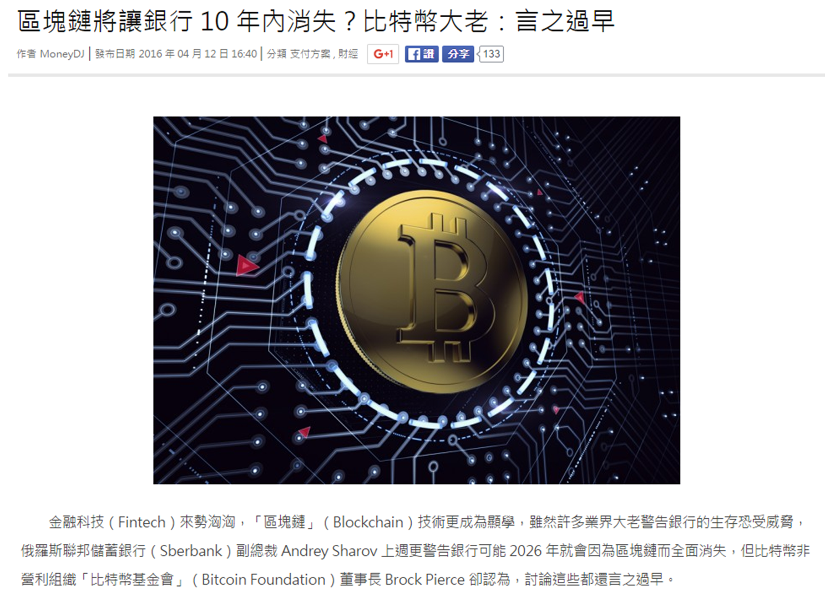
http://finance.technews.tw/2016/04/12/blockchain-bank-fintech

Slide 4
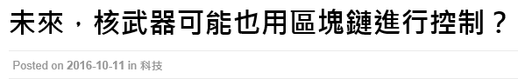
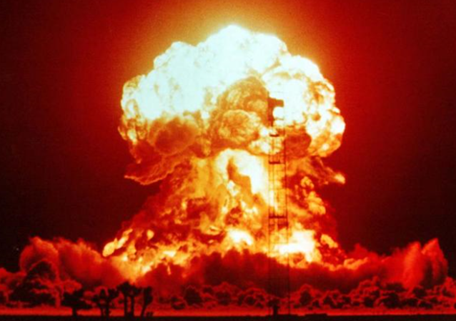
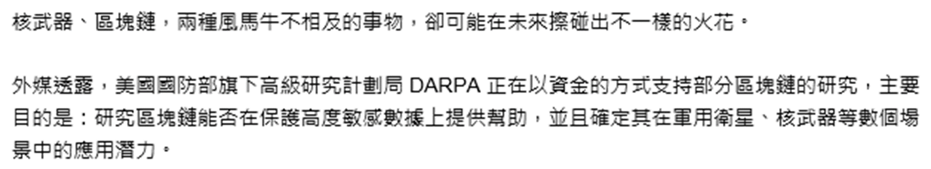
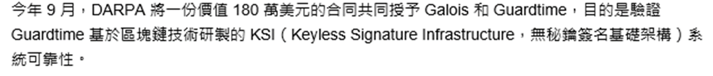
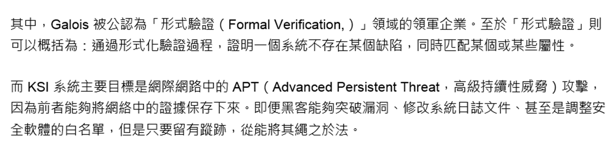
https://kknews.cc/tech/m4kmbp.html

Slide 5



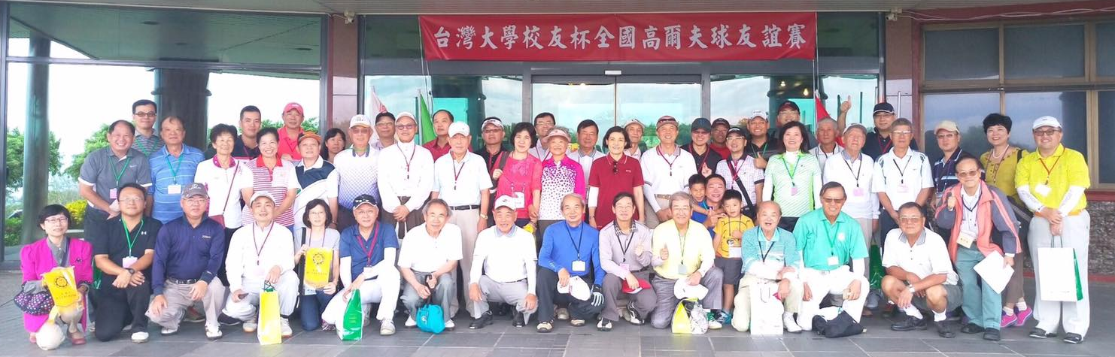
關於講者
臺大數學系 學士 碩士
美國 Purdue University 數學博士

Slide 6
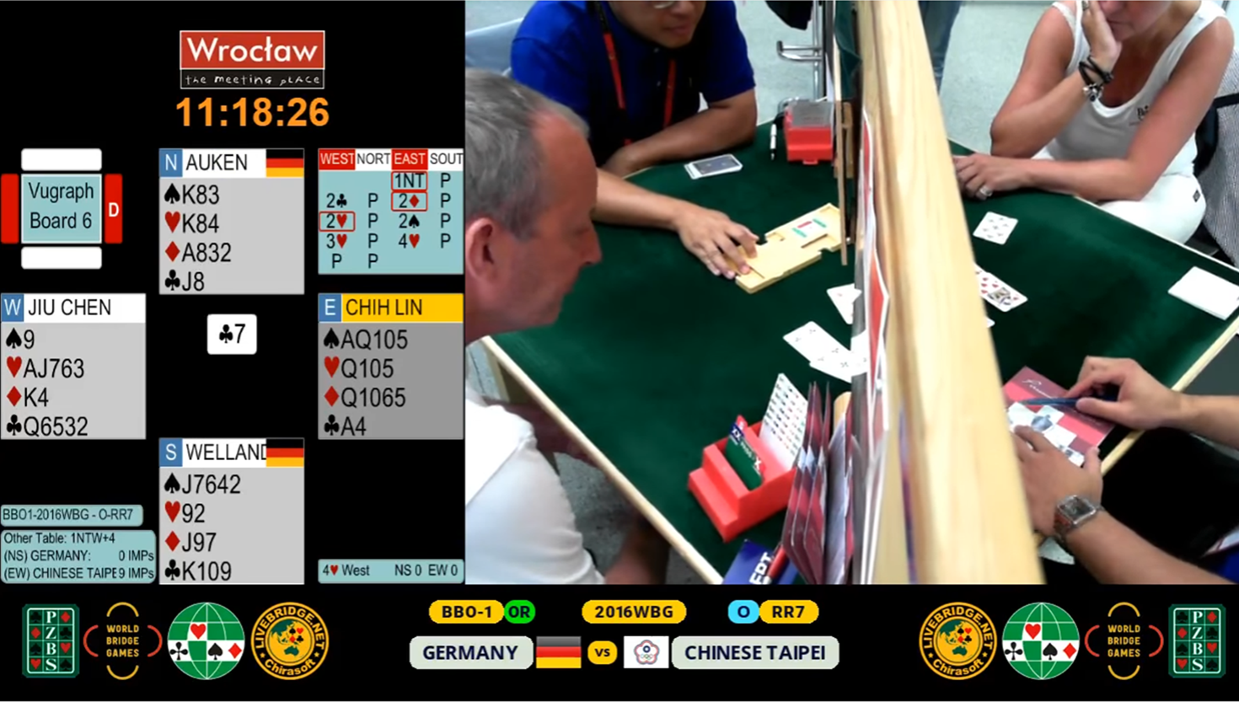
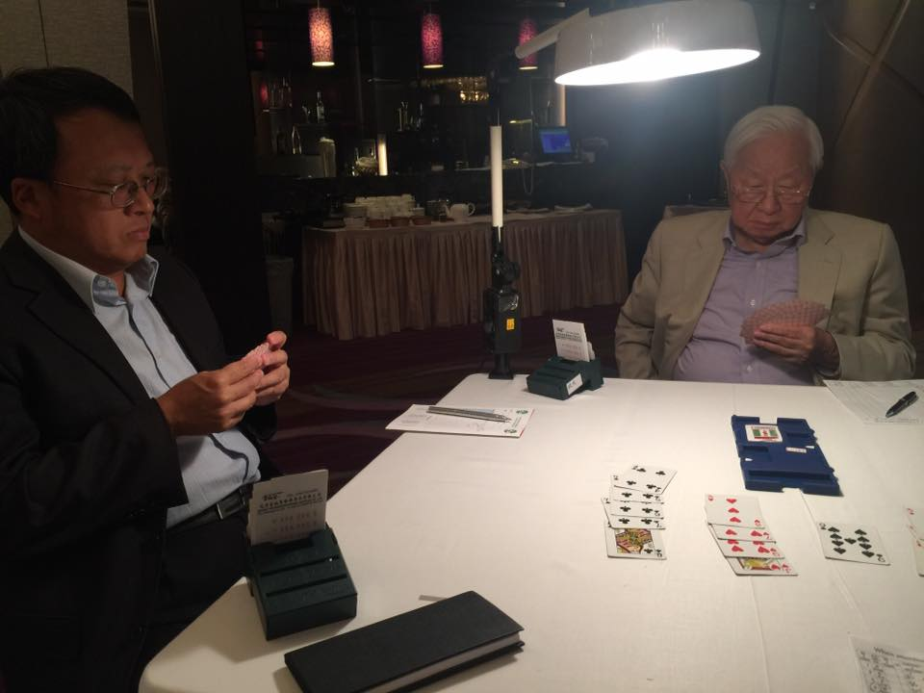
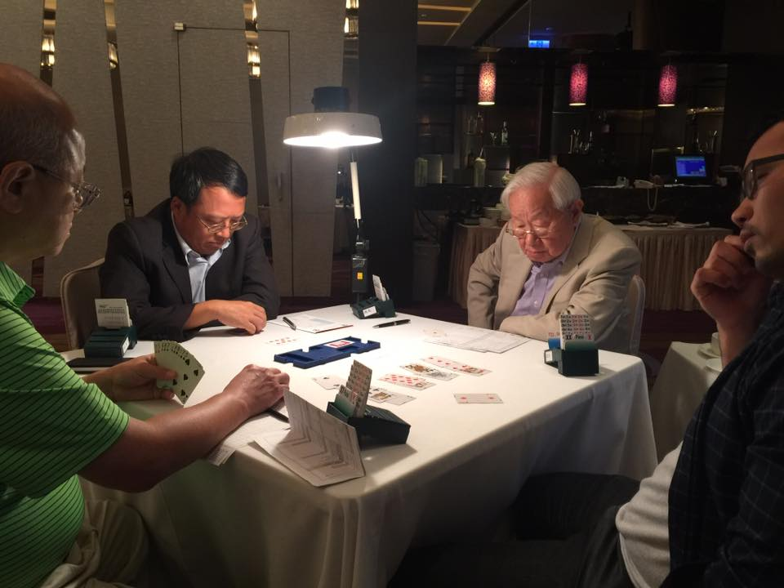

Slide 7
大綱
金融科技
密碼元件
運作原理
重點新聞
應用與演進
2.1 橢圓曲線數位簽章 (ECDSA)
橢圓曲線 (Elliptic Curve)
數位簽章 (Digital Signature)
Bitcoin 交易 (Transactions)
2.2 雜湊函數 (Hash Function)
定義與性質
默克樹 (Merkle Tree)
Bitcoin 區塊鏈

Slide 8
大綱
金融科技
密碼元件
運作原理
重點新聞
應用與演進

Slide 9
金融科技 FinTech
FinTech (Financial Technology) is a buzzword today
FinTech is an economic industry composed of companies that use technology to make financial services more efficient
FinTech companies are generally startups founded with the purpose of disrupting incumbent financial systems and corporations that rely less on software
https://en.wikipedia.org/wiki/Financial_technology

Slide 10
FinTech 基礎建設
FinTech基礎建設
行動 通訊
生物 辨識
雲端 服務
大數據
區塊鏈
來源 : 金管會 (金融監督管理委員會)
金融科技發展策略白皮書 2016.5.12
http://www.fsc.gov.tw/ch/home.jsp?id=478&parentpath=0,7

Slide 11
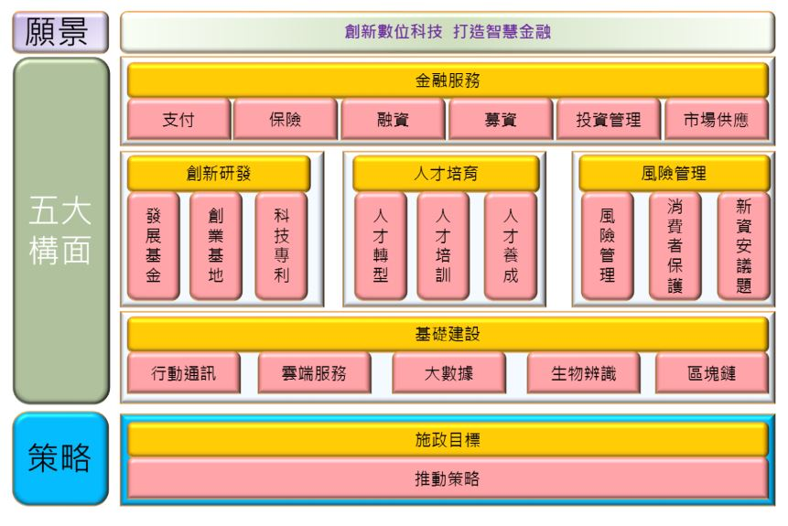
FinTech 政策白皮書內文架構

Slide 12
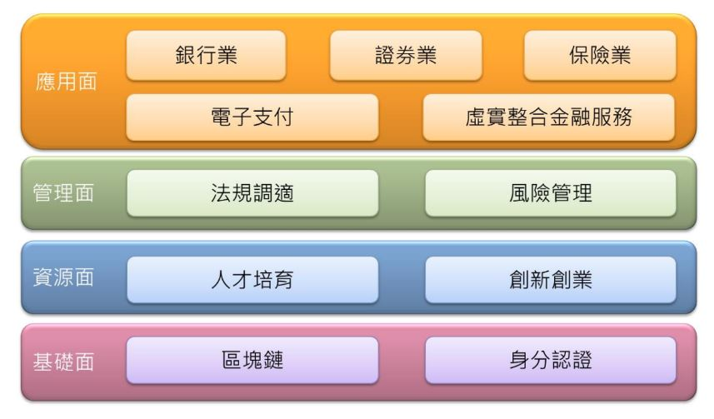
政策四大面向 十一項重點
Crypto
Inside!

Slide 13

iThome 區塊鏈專欄
http://www.ithome.com.tw/article/105368

Slide 14
Block Chain 區塊鏈
一言以蔽之︰「以 hash function 串接資料」
Hash function − 雜湊函數、赫序函數、哈希函數
探討區塊鏈的文獻極多，大部分著墨於應用，鮮少講清楚最根本的 hash function
Hash function 是基礎密碼演算法，實務應用非常普遍
區塊鏈來自 Bitcoin (比特幣)，後起之秀 (例如 Ethereum 以太坊 / 以色龍、Zcash) 基本架構類似，因此將從 Bitcoin 開始介紹

Slide 15
大綱
金融科技
密碼元件
運作原理
重點新聞
應用與演進
2.1 橢圓曲線數位簽章 (ECDSA)
橢圓曲線 (Elliptic Curve)
數位簽章 (Digital Signature)
Bitcoin 交易 (Transactions)
2.2 雜湊函數 (Hash Function)
定義與性質
默克樹 (Merkle Tree)
Bitcoin 區塊鏈

Slide 16





Cryptography 密碼學

Slide 17
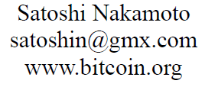
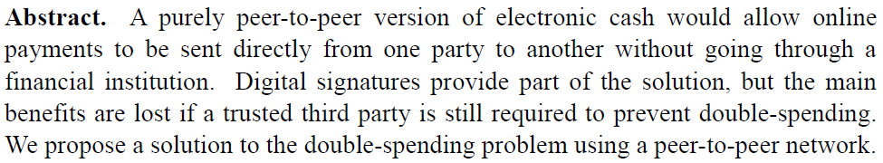
Birth of Bitcoin
Described by Satoshi Nakamoto (中本聰) in 2008
Introduced as open-source software on the evening of January 3, 2009
http://bitcoin.org/bitcoin.pdf 中本聰

Slide 18
Bitcoin Tutorial
How the Bitcoin protocol actually works
Published by Michael Nielsen on December 6, 2013
http://www.michaelnielsen.org/ddi/how-the-bitcoin-protocol-actually-works
“This is the best explanation of the Bitcoin protocol that I have read” by Bruce Schneier https://www.schneier.com/blog/archives/2013/12/bitcoin_explana.html
“To understand the post, you need to be comfortable with public key cryptography, and with the closely related idea of digital signatures. I’ll also assume you’re familiar with cryptographic hashing.”
“In the world of atoms we achieve security with devices such as locks, safes, signatures, and bank vaults. In the world of bits we achieve security with cryptography. That is why Bitcoin is at heart a cryptographic protocol.”

Slide 19
大綱
金融科技
密碼元件
運作原理
重點新聞
應用與演進
2.1 橢圓曲線數位簽章 (ECDSA)
橢圓曲線 (Elliptic Curve)
數位簽章 (Digital Signature)
Bitcoin 交易 (Transactions)
2.2 雜湊函數 (Hash Function)
定義與性質
默克樹 (Merkle Tree)
Bitcoin 區塊鏈

Slide 20
Group 群
Definition A group (G, ∗) is a set G with an operation ∗ , such that the following conditions are satisfied：
Closure a ∗ b ∈ G for all a, b ∈ G
Associativity a ∗ (b ∗ c) = (a ∗ b) ∗ c for all a, b, c ∈ G
Identity There is an element e ∈ G such that a = a ∗ e = e ∗ a for each a ∈ G
Inverse For each a ∈ G, there is an element b ∈ G such that a ∗ b = b ∗ a = e

Slide 21
Group
Example Each of the following sets with the specified operation is a group
Z, Q, R, C with + (addition)
Q*, R*, C* with × (multiplication)
5Z = { 5a | a ∈ Z } with +
{1, -1} with ×
Z₆ = {0, 1, 2, 3, 4, 5} with + modulo 6
Z₇* = {1, 2, 3, 4, 5, 6} with × modulo 7
{(x, y) ∈ R ² | y ² = x ³ + ax + b } ∪ {∞} with point addition and point doubling laws on elliptic curves

Slide 22
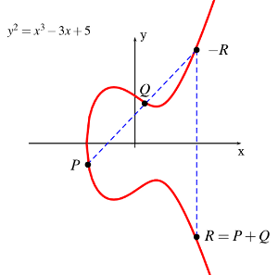
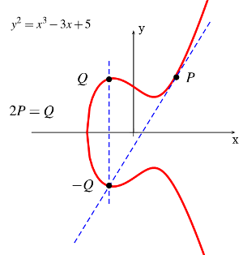
Elliptic Curve 橢圓曲線
The rich and deep theory of Elliptic Curves has been studied by mathematicians over 150 years
Elliptic Curve over R : y² = x³ + ax + b
Point Addition
Point Doubling
Image Courtesy: http://www.embedded.com/design/safety-and-security/4396040/An-Introduction-to-Elliptic-Curve-Cryptography

Slide 23
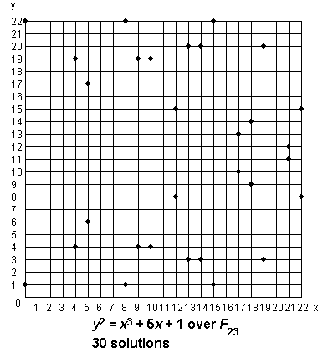
質數體 (Prime Field) 上的曲線
24G
25G
13G
Addition:
(x₃, y₃) = (x₁, y₁) + (x₂, y₂)
Doubling:
(x₃, y₃) = [2] (x₁, y₁)
10G
27G
29G
23G
19G
16G
30G
14G
5G
3G
9G
11G
20G
22G
17G
26G
28G
G(5,6)
4G
12G
15G
2G
8G
21G
7G
6G
18G

Slide 24
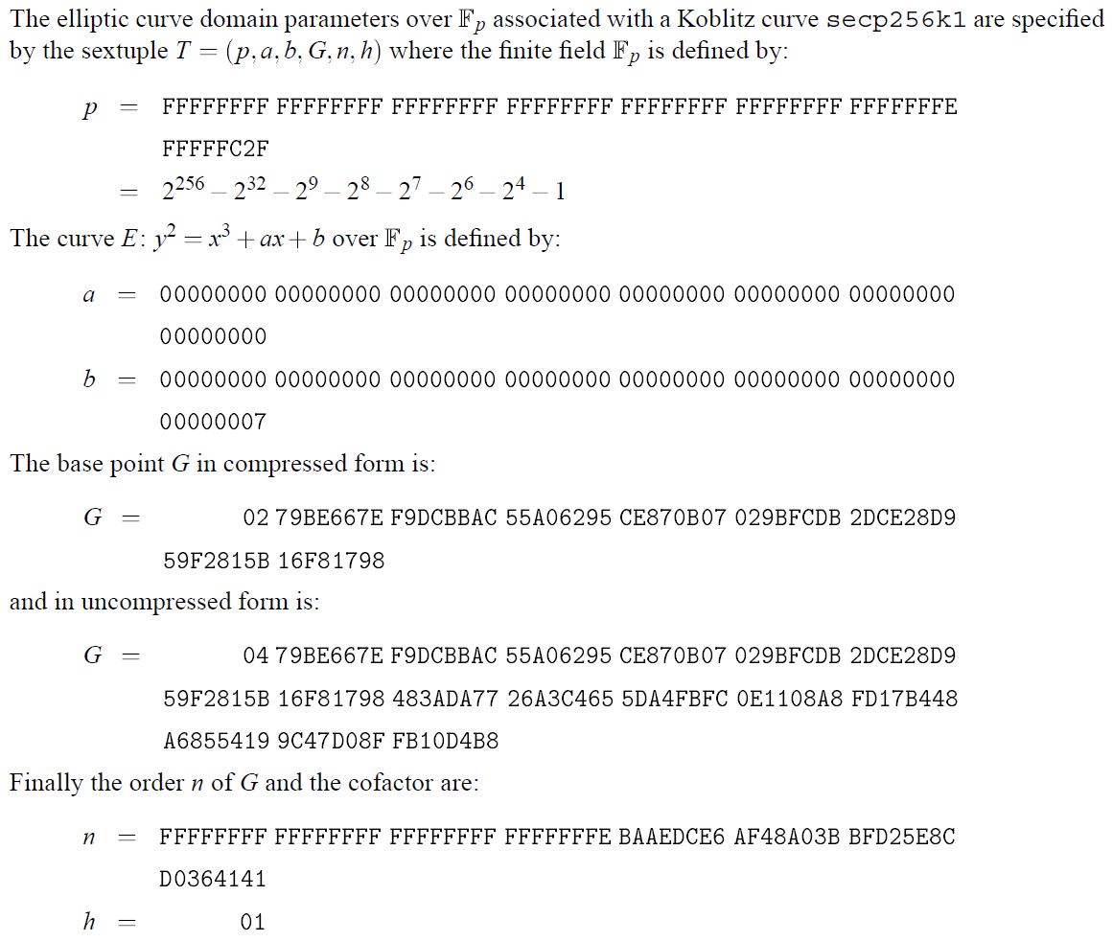
Bitcoin 和 Ethereum 使用的曲線
256-bit prime
橢圓曲線 secp256k1
https://en.bitcoin.it/wiki/Secp256k1
256-bit prime

Slide 25
傳統對稱式密碼系統
Encrypt 加密
↗ ↑ ↘
Plaintext 明文 Symmetric key Ciphertext 密文
↖ ↓ ↙
Decrypt 解密
DES (Data Encryption Standard)
AES (Advanced Encryption Standard)

Slide 26
私密金鑰 與 公開金鑰
容易計算
私密金鑰 公開金鑰
Private Key 非常困難 Public Key
藉由數學工具達成此目的
Whit Diffie 和 Martin Hellman 於 1976 年提出此觀念

Slide 27
Public Key Cryptosystem 公開金鑰密碼系統
Public key
↓
Plaintext 明文 → Encrypt 加密
↖ ↘
Decrypt 解密 ← Ciphertext 密文
↑
Private key
RSA (Rivest – Shamir – Adleman 1977)
ECC (Elliptic Curve Cryptosystem 橢圓曲線密碼系統)

Slide 28
Digital Signature 數位簽章
Public key
↓
Signature → Verify 驗章
↖ ↘
Sign 簽章 ← Message
↑
Private key
* 資料完整性 (Integrity)
* 身份鑑別性 (Authentication)
* 不可否認性 (Non-Repudiation)

Slide 29
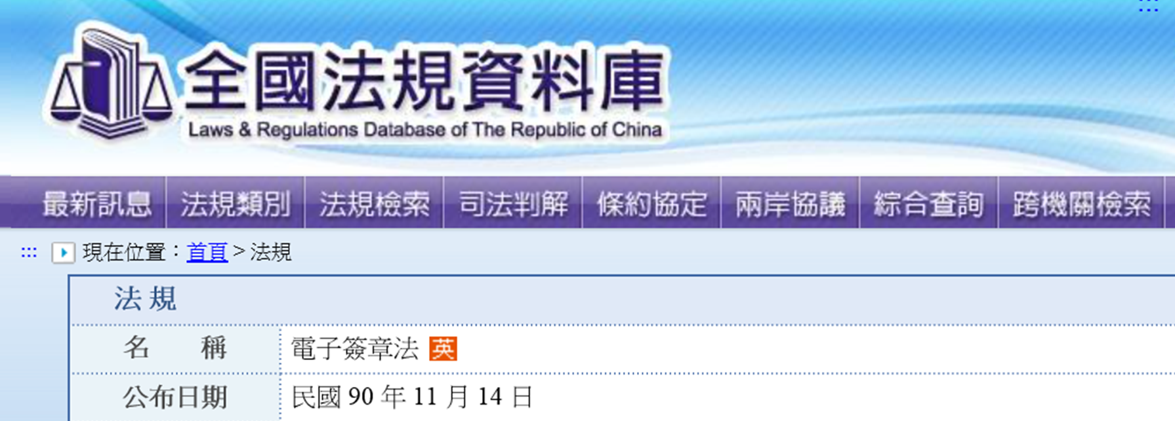
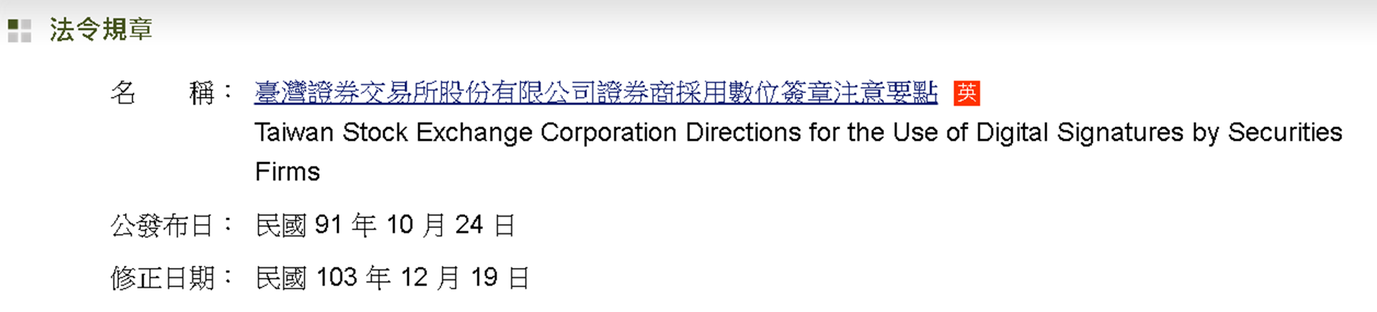

數位簽章法律與應用

Slide 30
Key Pairs 金鑰對
The base point G is fixed on the given Elliptic Curve
P = [m] G
Given m, it is easy and fast to find the point P
Using “double and add” for scalar multiplication
Given P, it is extremely hard to find the integer m
Elliptic Curve Discrete Logarithm Problem (橢圓曲線離散對數問題)
A randomly generated integer m is a private key
A private key is used to sign Bitcoin transactions with ECDSA
The point P is the public key corresponding to m
A public key is used by other nodes to verify Bitcoin transactions
A Bitcoin address is the hash value of a public key P

Slide 31
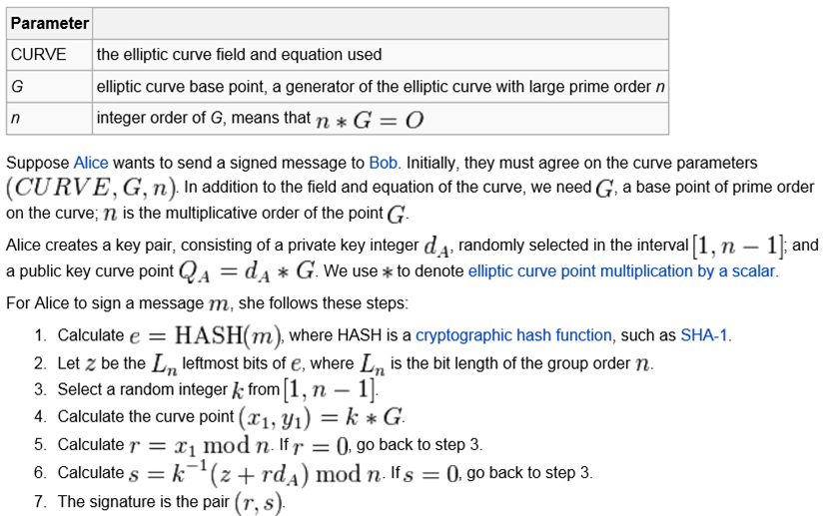
ECDSA Signing 簽章
k : ephemeral key
http://en.wikipedia.org/wiki/Elliptic_Curve_DSA

Slide 32
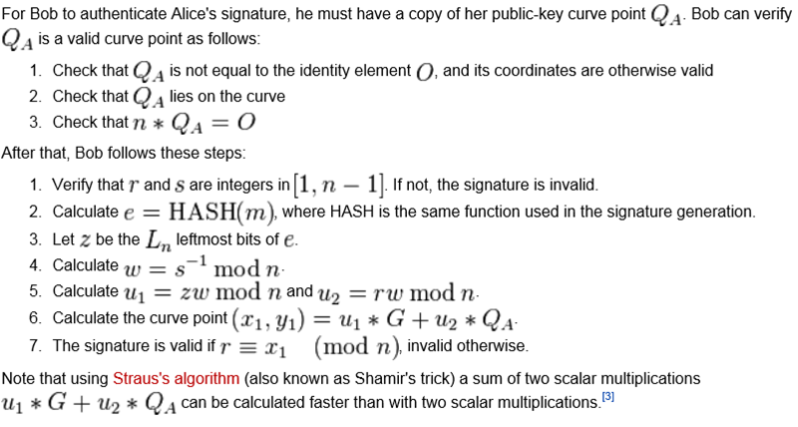
ECDSA Verification 驗章
http://en.wikipedia.org/wiki/Elliptic_Curve_DSA

Slide 33
Ephemeral Key & RNG
The entropy, secrecy, and uniqueness of the DSA / ECDSA random ephemeral key k is critical
Violating any one of the above three requirements can reveal the entire private key to an attacker
Using the same value twice (even while keeping k secret), using a predictable value, or leaking even a few bits of k in each of several signatures, is enough to break DSA / ECDSA
[December 2010] The ECDSA private key used by Sony to sign software for the PlayStation 3 game console was recovered, because Sony implemented k as static instead of random
http://en.wikipedia.org/wiki/Digital_Signature_Algorithm http://en.wikipedia.org/wiki/Elliptic_Curve_DSA

Slide 34
Ephemeral Key & RNG
[August 2013] Bugs in some implementations of the Java class SecureRandom sometimes generated collisions in k, allowing in stealing bitcoins from the containing wallet on Android app
http://www.theregister.co.uk/2013/08/12/android_bug_batters_bitcoin_wallets
[August 2013] 158 accounts had used the same signature nonces r value in more than one signature. The total remaining balance across all 158 accounts is only 0.00031217 BTC. The address, 1HKywxiL4JziqXrzLKhmB6a74ma6kxbSDj, appears to have stolen bitcoins from 10 of these addresses. This account made 11 transactions between March and October 2013. These transactions have netted this account over 59 bitcoins (approximately $12,000 USD).
http://eprint.iacr.org/2013/734.pdf
This issue can be prevented by deriving k deterministically from the private key and the message hash, as described by RFC 6979

Slide 35
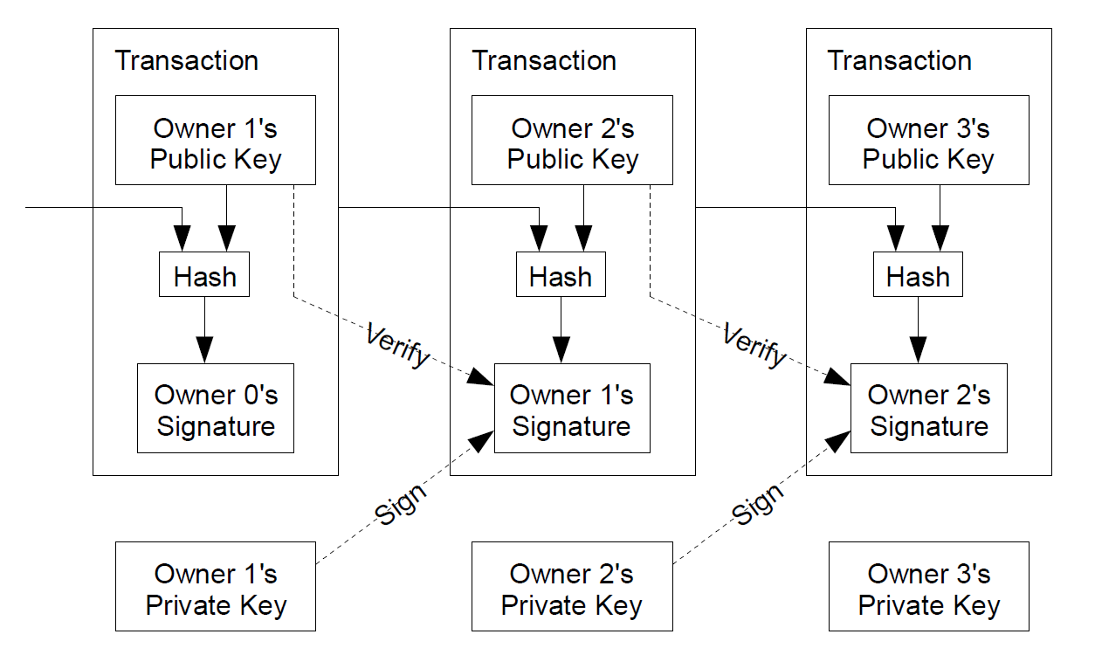
Bitcoin Transactions 交易
Must be protected very well!!!
http://bitcoin.org/bitcoin.pdf 中本聰

Slide 36
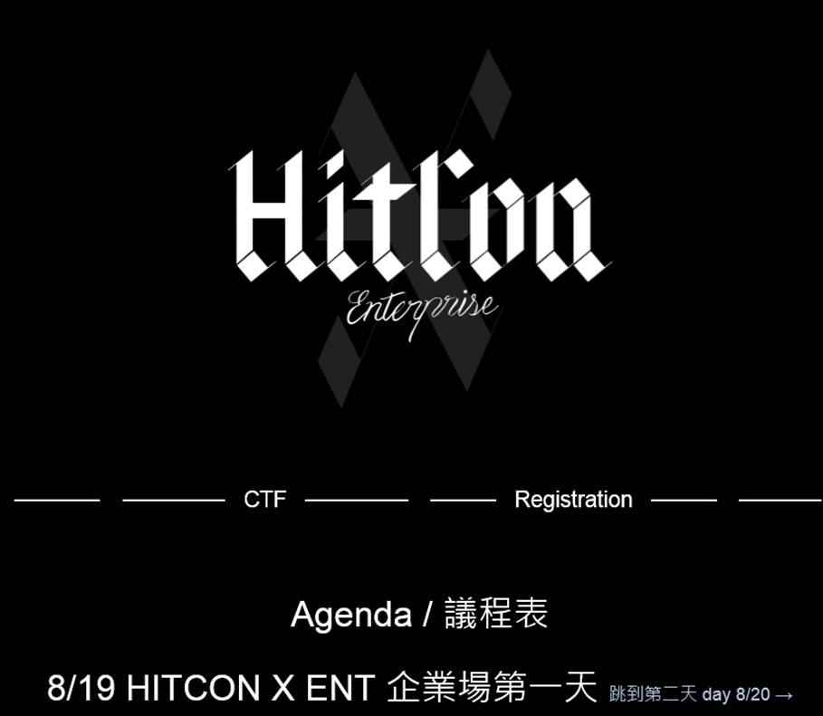
HITCON 2014 台灣駭客年會 企業場

Slide 37
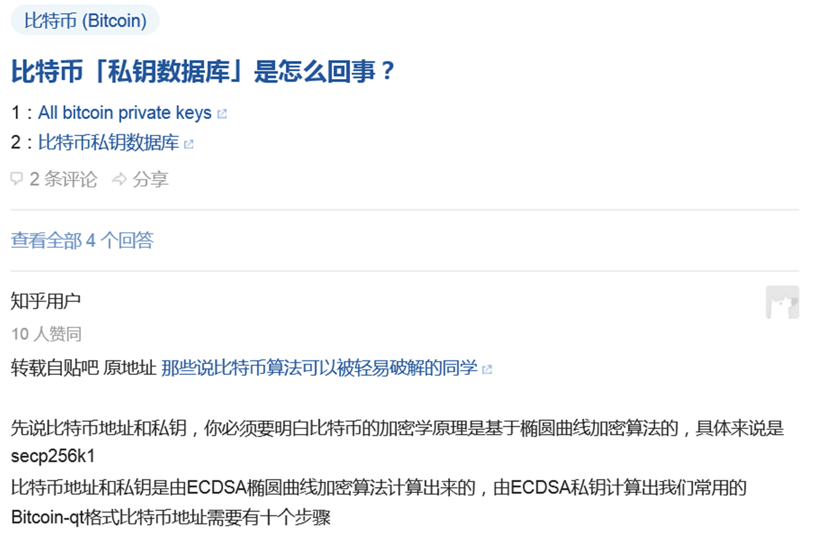
私鑰數據庫?
https://www.zhihu.com/question/23608006/answer/25141783

Slide 38
常見誤解
Bitcoin protocol 沒有「加密」，僅數位簽章
中本聰論文的全文無任何 encrypt / encryption，而 sign / signing / signature 出現 12 次
許多文章強調 Bitcoin 以橢圓曲線密碼系統對交易資料進行加密保護，此為錯誤敘述
保護私鑰可能需使用加密，但它不屬於比特幣協定，由使用者錢包自行處理對私鑰的保護

Slide 39
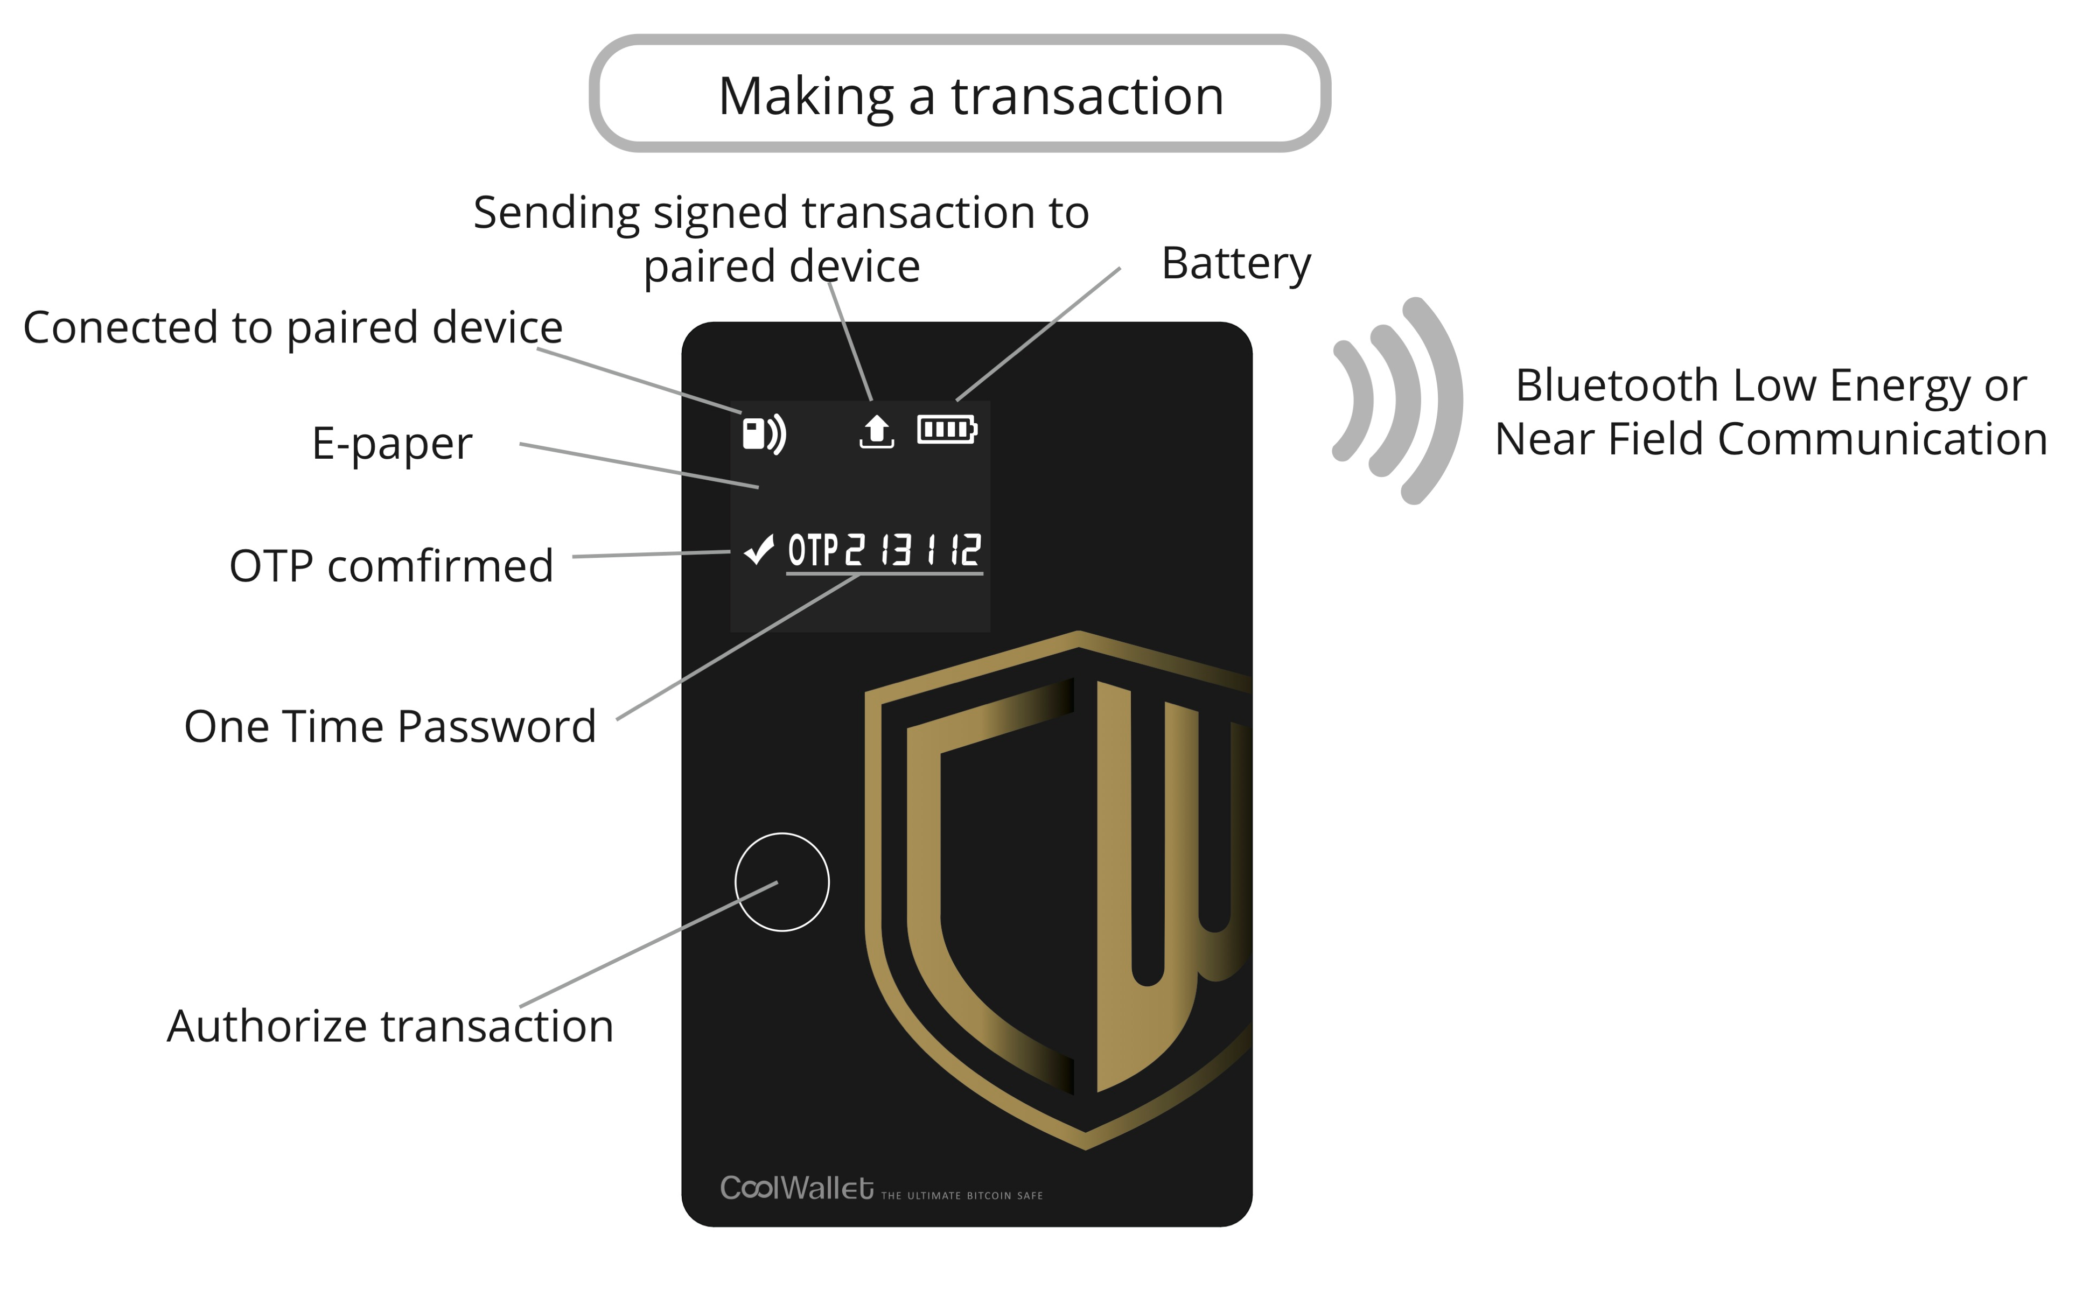
CoolWallet
英飛凌 Infineon
SLE97 安全晶片

Slide 40

HITCON 2015 台灣駭客年會 企業場

Slide 41
Side-Channel Attacks
D (double) or A (add) depends on the bits of Private Key
Image Courtesy − https://eprint.iacr.org/2015/354.pdf

Slide 42

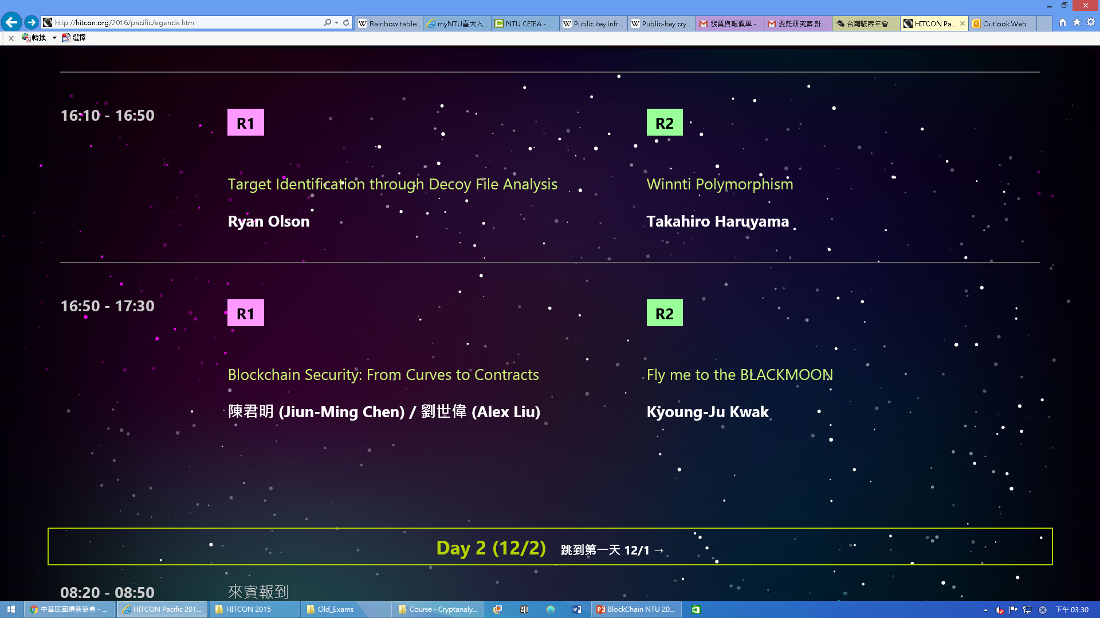
Blockchain Security: From Curves to Contracts

Slide 43
大綱
金融科技
密碼元件
運作原理
重點新聞
應用與演進
2.1 橢圓曲線數位簽章 (ECDSA)
橢圓曲線 (Elliptic Curve)
數位簽章 (Digital Signature)
Bitcoin 交易 (Transactions)
2.2 雜湊函數 (Hash Function)
定義與性質
默克樹 (Merkle Tree)
Bitcoin 區塊鏈

Slide 44
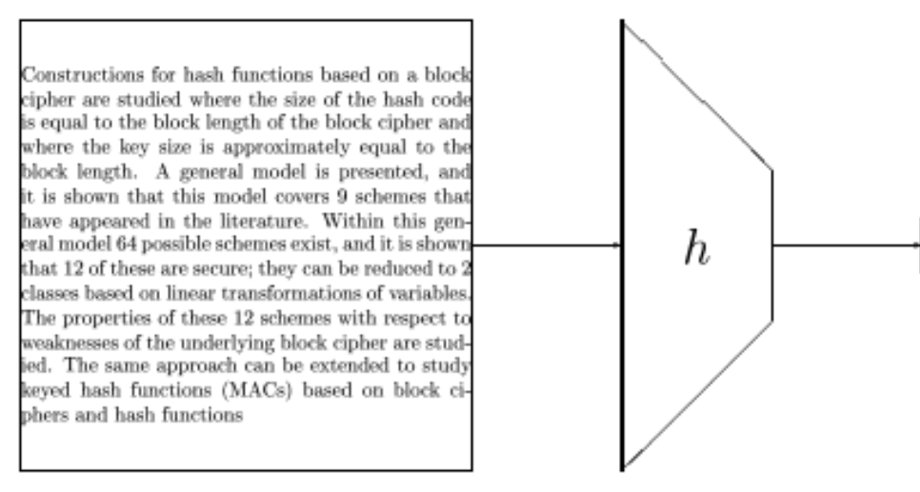

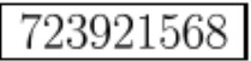
Hash Functions 雜湊函數
An efficient function mapping binary strings of arbitrary length to binary strings of fixed length, called the hash-value or hash-code (fingerprint, checksum)

Slide 45
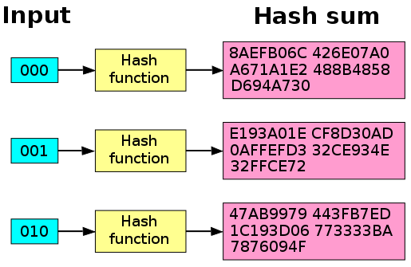
Avalanche Effect 雪崩效應
A desirable property of cryptographic algorithms, typically block ciphers and cryptographic hash functions
When an input is changed slightly (e.g., flipping a single bit) the output changes significantly (e.g., half the output bits flip)
The SHA-1 hash function exhibits good avalanche effect. When a single bit is changed the hash sum
becomes completely different.
https://en.wikipedia.org/wiki/Avalanche_effect

Slide 46
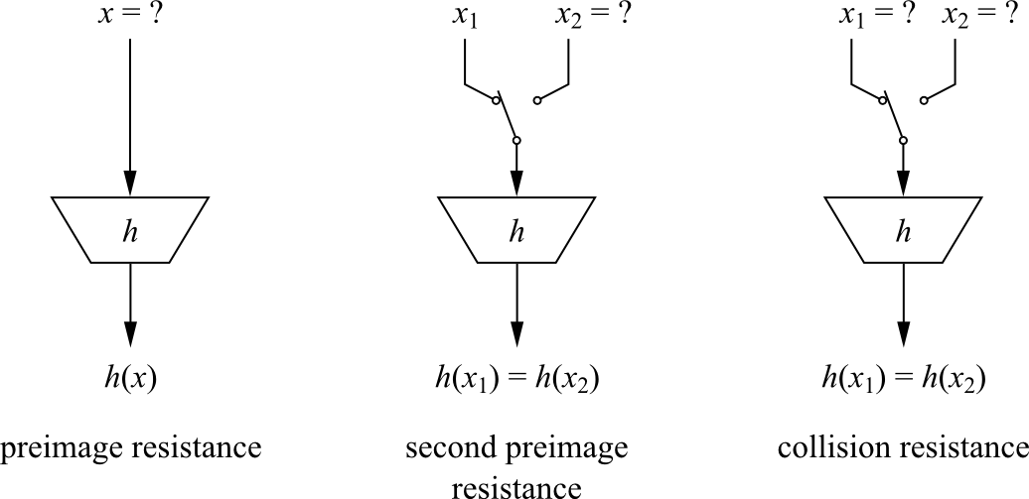
Security Properties 安全性質

Slide 47
Cryptographic Hash Functions 密碼雜湊函數
H is a function with one-way property (pre-image resistance) if given any y, it is computationally infeasible to find any value x in the domain of H such that H(x) = y
H is collision free (resistant) if it is computationally infeasible to find x' ≠ x such that H(x' ) = H(x)
H is a cryptographic hash function if
Input: bit strings of arbitrary length
Output: bit strings of fixed length
H has one-way property
H is collision free

Slide 48
Applications
Verifying the Integrity of Files or Messages
Password Verification
File or Data Identifier
Pseudorandom Generation & Key Derivation
Proof-of-Work (POW)
https://en.wikipedia.org/wiki/Cryptographic_hash_function

Slide 49
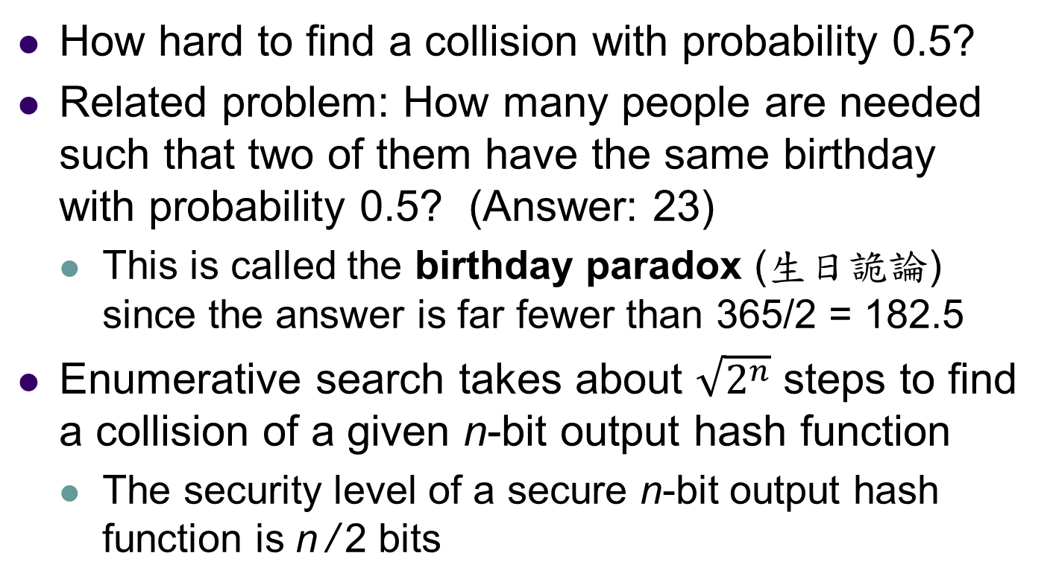
Cryptanalysis 密碼分析
How hard to find a collision with probability 0.5?
Related problem: How many people are needed such that two of them have the same birthday with probability 0.5? (Answer: 23)
This is called the birthday paradox (生日詭論) since the answer is far fewer than 365/2 = 182.5
Enumerative search takes about $\sqrt{2^{n}}$ steps to find a collision of a given n-bit output hash function
The security level of a secure n-bit output hash function is n / 2 bits

Slide 50
SHA: Secure Hash Algorithm
The Secure Hash Algorithm is a family of cryptographic hash functions published by the National Institute of Standards and Technology (NIST) as a U.S. Federal Information Processing Standard (FIPS)
Algorithm and variant |  | Output size (bits) | Internal state size (bits) | Block size (bits) | Rounds | Bitwise operations | Security (bits)
SHA-1 FIPS 180 |  | 160 | 160 | 512 | 80 | and, or, add, xor, rot | Theoretical attack (2⁶¹)
SHA-2 FIPS 180 | SHA-224 SHA-256 | 224 256 | 256 (8 × 32) | 512 | 64 | and, or, xor, shr, rot, add | 112 128
 | SHA-384 SHA-512 SHA-512/224 SHA-512/256 | 384 512 224 256 | 512 (8 × 64) | 1024 | 80 | and, or, xor, shr, rot, add | 192 256 112 128
SHA-3 FIPS 202 | SHA3-224 SHA3-256 SHA3-384 SHA3-512 | 224 256 384 512 | 1600 (5 × 5 × 64) | 1152 1088 832 576 | 24 | and, xor, rot, not | 112 128 192 256
Bitcoin
Ethereum
(Keccak 256)
https://en.wikipedia.org/wiki/Secure_Hash_Algorithm

Slide 51
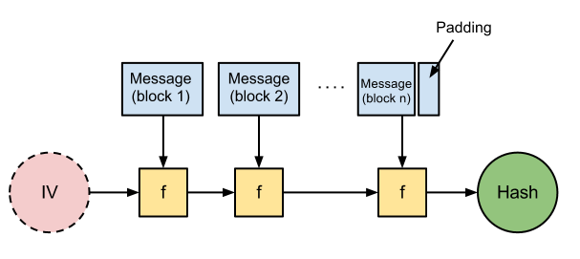

Merkle-Damgård Construction for SHA-1 / SHA-2
Image Courtesy http://joncave.co.uk/2012/08/i-captured-the-flag

Slide 52
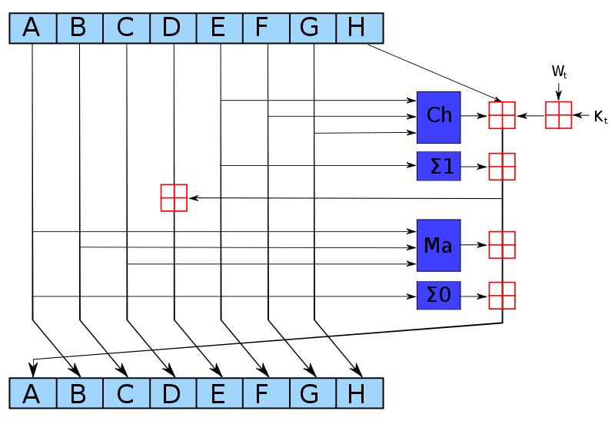
SHA-256
One iteration in a SHA-2 family compression function
The blue components perform the following operations
The bitwise rotation uses different constants for SHA-512
The given numbers are for SHA-256
is addition modulo 2³²
http://en.wikipedia.org/wiki/SHA-2

Slide 53
SHA-3 Competition Winner: Keccak
Designers:
Guido Bertoni (Italy) of STMicroelectronics
Joan Daemen (Belgium) of STMicroelectronics
Gilles Van Assche (Belgium) of STMicroelectronics
Michaël Peeters (Belgium) of NXP Semiconductors
Not very fast in software implementation, but in hardware implementations it is notably faster than all other finalists
In its largest instance, the state consists of a 5 × 5 array of 64-bit words, 1600 bits total
Reduced versions are defined for smaller power-of-2 word sizes w down to 1 bit (25 bits total state)
Smaller state sizes can be used to test cryptanalytic attacks
Intermediate state sizes (e.g., from w = 4, 100 bits, to w = 32, 800 bits) also provide practical, lightweight, alternatives

Slide 54
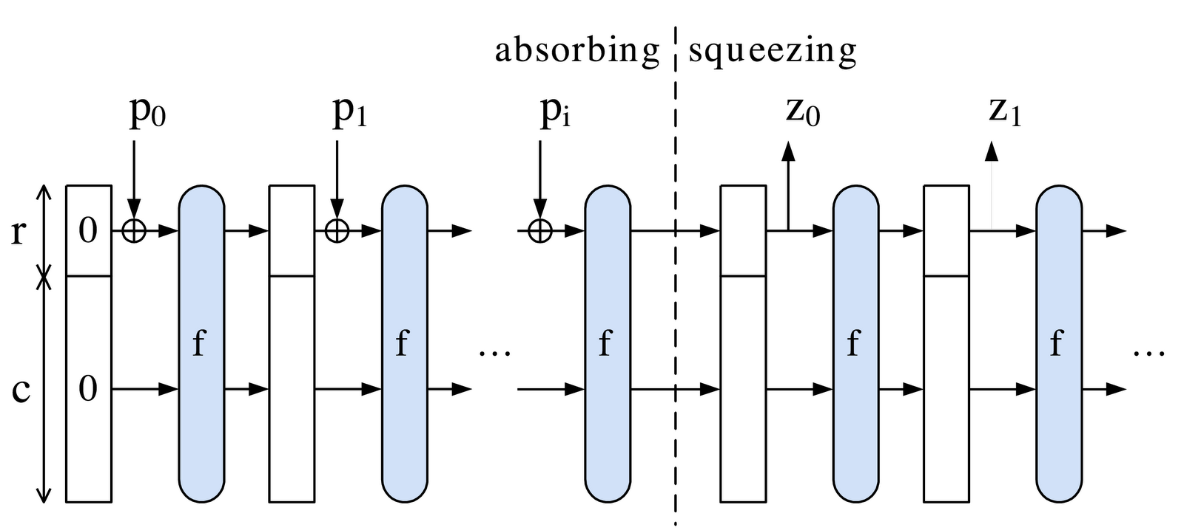
SHA-3 / Keccak: Sponge Construction

Slide 55
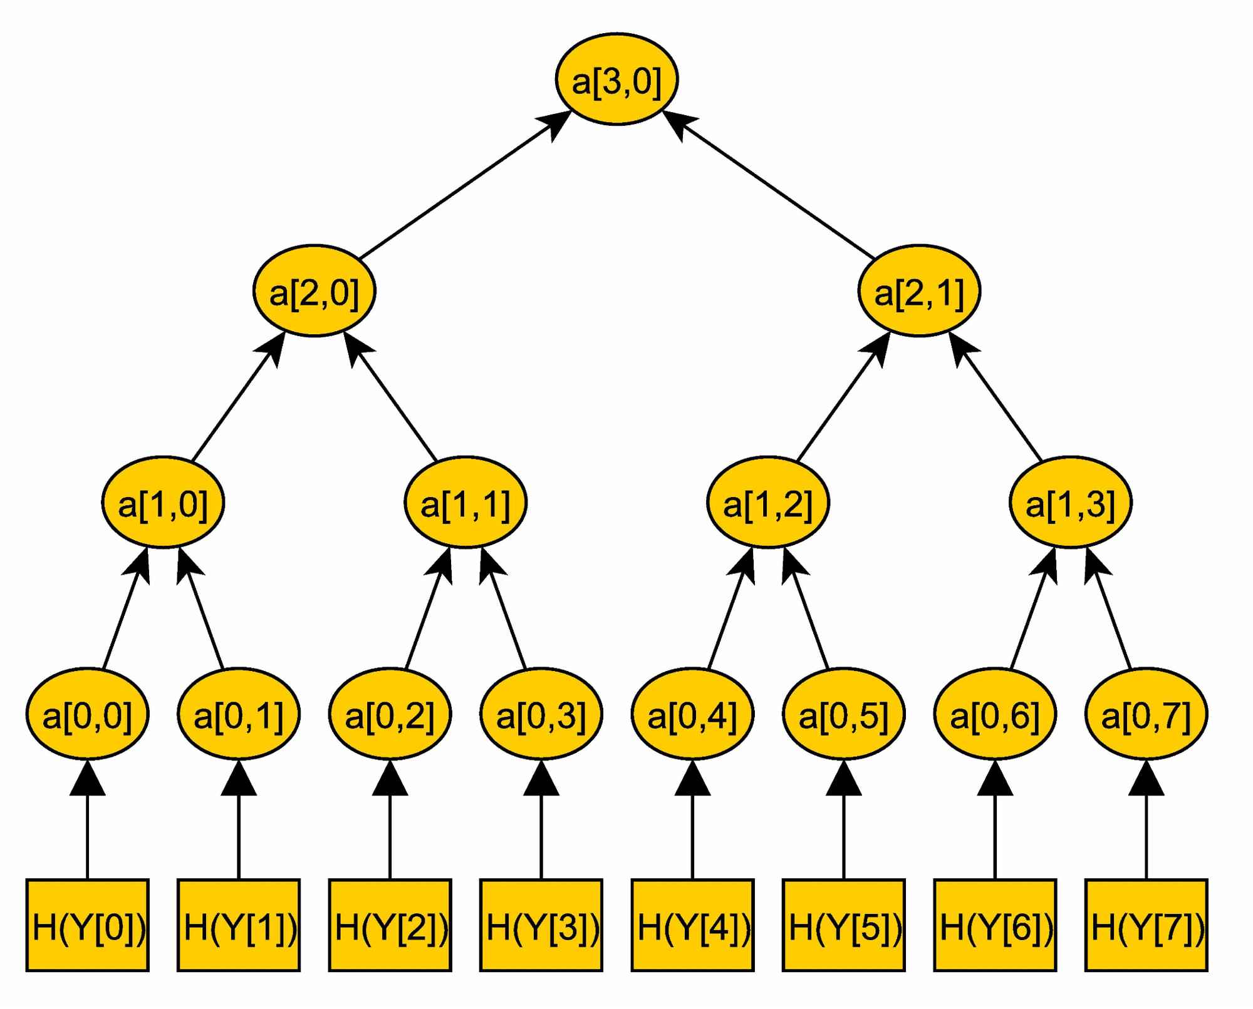
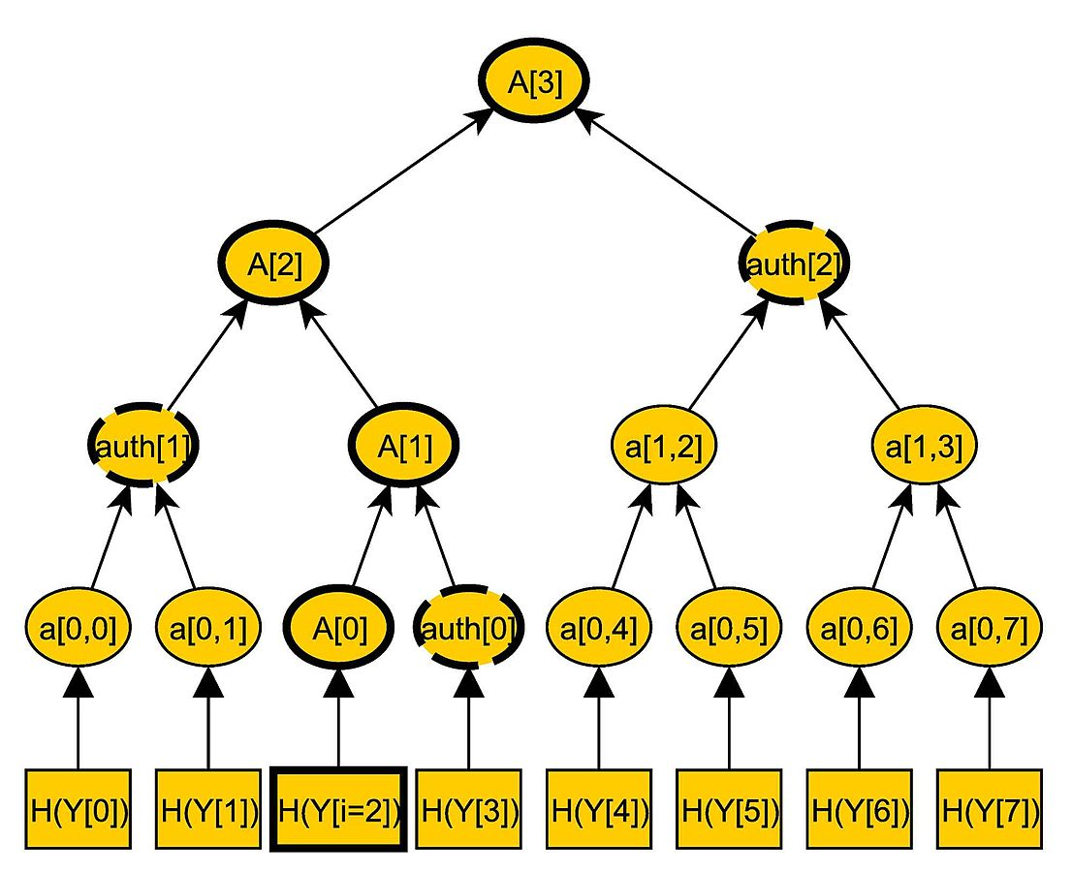
Merkle Tree / Hash Tree
Block
Merkle Root
Block
http://commons.wikimedia.org/wiki/File:MerkleTree1.jpg
http://commons.wikimedia.org/wiki/File:MerkleTree2.jpg

Slide 56
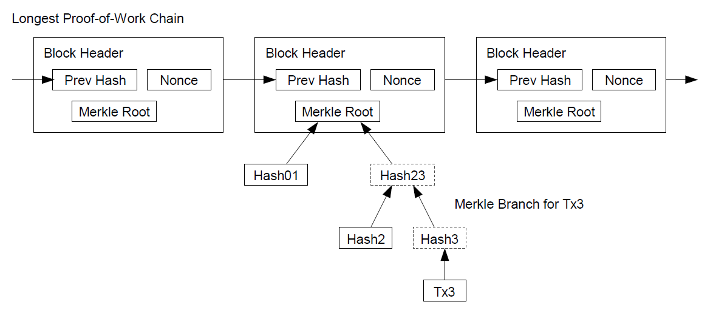
Block Chain
Mining 挖礦
http://bitcoin.org/bitcoin.pdf 中本聰

Slide 57
Hash Function Usages
Merkle Tree and Block Hash
Double SHA256, i.e., SHA256(SHA256())
Bitcoin Address
RIPEMD160(SHA256(public key representation))
Example
ECDSA private key = 18E14A7B6A307F426A94F8114701E7C8E774E7F9A47E2C2035DB29A206321725
Public key P = 04 50863AD64A87AE8A2FE83C1AF1A8403CB53F53E486D8511DAD8A04887E5B235
22CD470243453A299FA9E77237716103ABC11A1DF38855ED6F2EE187E9C582BA6
SHA256(P) = 600FFE422B4E00731A59557A5CCA46CC183944191006324A447BDB2D98D4B408
RIPEMD160(SHA256(P)) = 010966776006953D5567439E5E39F86A0D273BEE
Address (Base58Check encoded): 16UwLL9Risc3QfPqBUvKofHmBQ7wMtjvM
https://en.bitcoin.it/wiki/Technical_background_of_version_1_Bitcoin_addresses#How_to_create_Bitcoin_Address

Slide 58
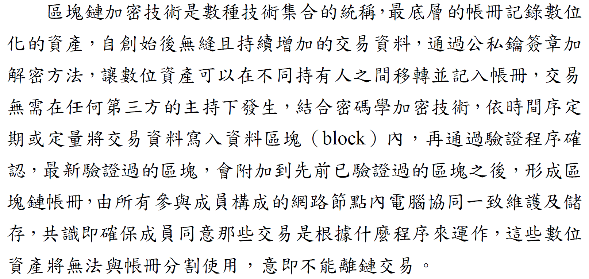
金融科技發展策略白皮書 p.93

Slide 59
大綱
金融科技
密碼元件
運作原理
重點新聞
應用與演進

Slide 60
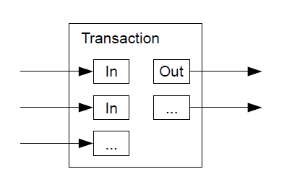
Combining & Splitting Value
“To allow value to be split and combined, transactions contain multiple inputs and outputs.”
http://bitcoin.org/bitcoin.pdf 中本聰

Slide 61
Transaction Data
{"hash":"7c4025... "
the hash of the remainder of the transaction (Data)
"ver":1,
version 1 of the Bitcoin protocol
"vin_sz":1,
one input
"vout_sz":1,
one output
"lock_time":0,
transaction is finalized immediately
"size":224,
size (in bytes) of the transaction
not transaction amount

Slide 62
"in":[
{"prev_out":
{"hash":"2007ae...",
where the money from
hash of previous transaction
"n":0},
it is the first output from that transaction
"scriptSig":"304502... 042b2d..."}],
signature of the person sending the money
the corresponding public key followed by a space
"out":[
{"value":"0.31900000",
the value of the output
"scriptPubKey":"OP_DUP OP_HASH160 a7db6f OP_EQUAL
VERIFY OP_CHECKSIG”}]}
Bitcoin’s scripting language
Bitcoin address of the intended recipient (a7db6f)
http://www.michaelnielsen.org/ddi/how-the-bitcoin-protocol-actually-works

Slide 63
Incentive 激勵
“By convention, the first transaction in a block is a special transaction that starts a new coin owned by the creator of the block.”
2009.1.3 ~ 2012.11.28 (Block #0 ~ #209999): 50 bitcoins per block
2012.11.28 ~ 2016.7.9 (#210000 ~ #419999): 25 bitcoins per block
…… Done in 2140: All 21,000,000 bitcoins are issued
“The incentive can also be funded with transaction fees.”
“If the output value of a transaction is less than its input value, the difference is a transaction fee that is added to the incentive value of the block containing the transaction.”
http://bitcoin.org/bitcoin.pdf 中本聰

Slide 64
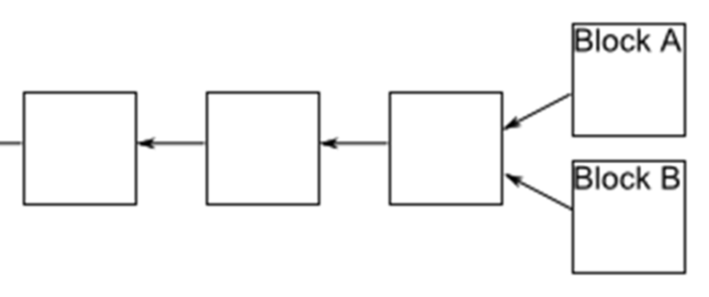
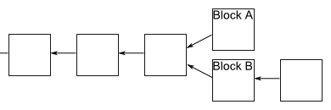
Block Forking 區塊分岔
Occasionally, a fork appears in the block chain, i.e., two miners happen to validate a block of transactions near-simultaneously
Some people update their block chain one way, and others update their block chain the other way
If a fork occurs, people on the network keep track of both forks
Miners only work to extend whichever fork is longest in their copy of the block chain

Slide 65
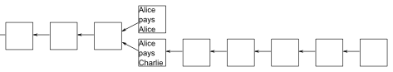
Confirmations
A transaction is not considered confirmed until
It is part of a block in the longest fork
At least 5 blocks follow it in the longest fork
In this case, we say that the transaction has “6 confirmations”
10 minutes per block (in average)
Payee must wait 60 minutes

Slide 66
Steps to Run the Network
New transactions are broadcast to all nodes
Each node collects new transactions into a block
Each node works on finding a difficult proof-of-work for its block
When a node finds a proof-of-work, it broadcasts the block to all nodes
Nodes accept the block only if all transactions in it are valid and not already spent
Nodes express their acceptance of the block by working on creating the next block in the chain, using the hash of the accepted block as the previous hash

Slide 67

Game Theory 賽局理論
Example: Prisoners’ Dilemma 囚徒困境
The optimal individual choices leads to a sub-optimal collective outcome
Prisoner B Prisoner A | stays silent 沉默 (cooperates 合作) | betrays 認罪 (defects 背叛)
stays silent 沉默 (cooperates 合作) | Each serves 1 year 各服刑一年 | Prisoner A: 3 years Prisoner B: goes free
betrays 認罪 (defects 背叛) | Prisoner A: goes free Prisoner B: 3 years | Each serves 2 years 各服刑兩年

Slide 68
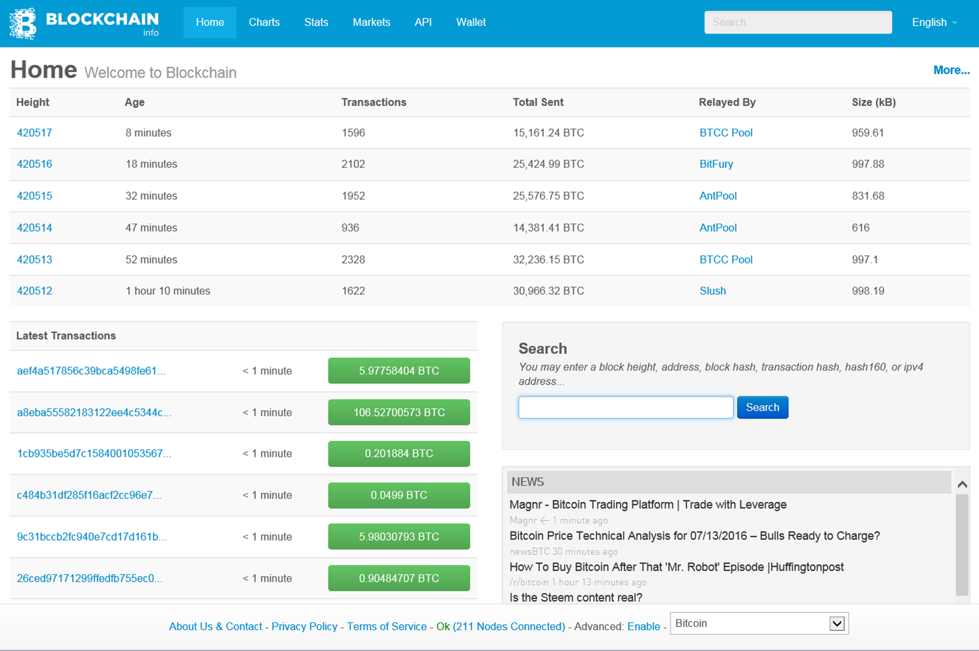
https://blockchain.info

Slide 69
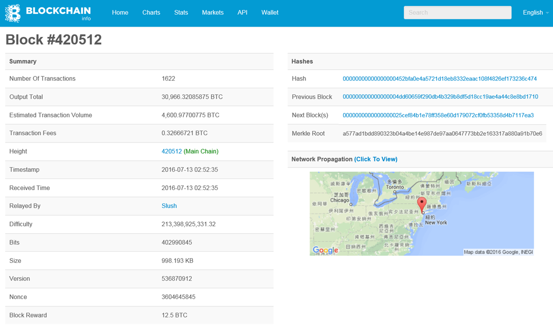

Slide 70
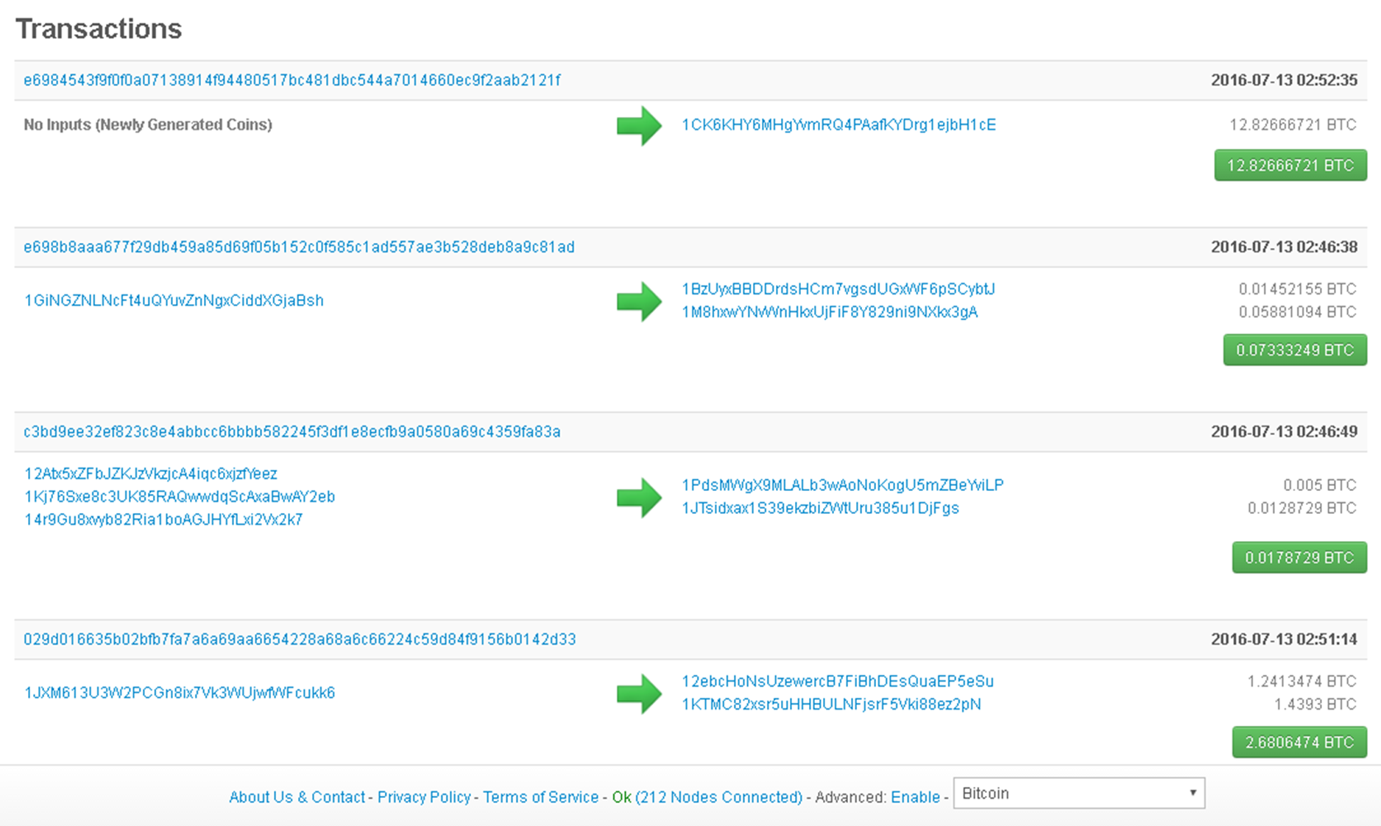


Slide 71
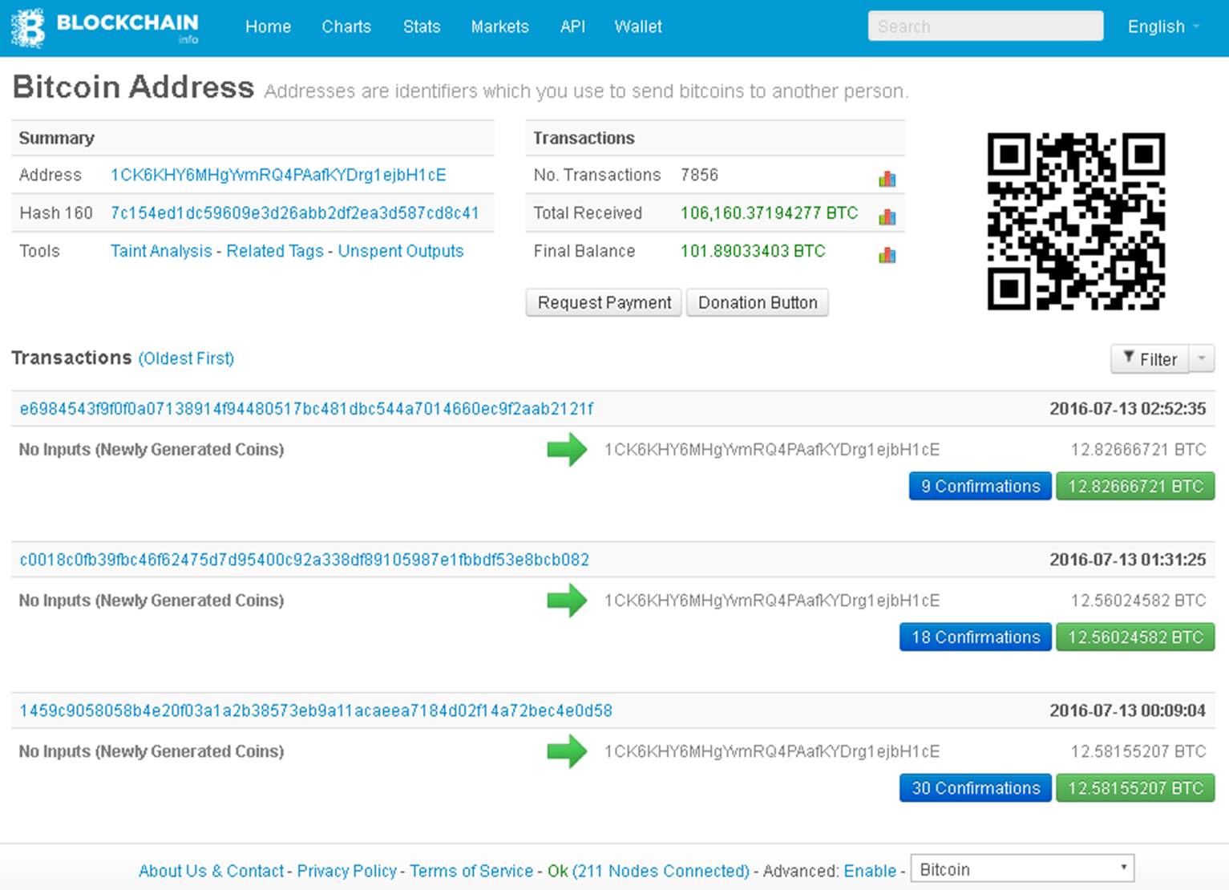

Slide 72
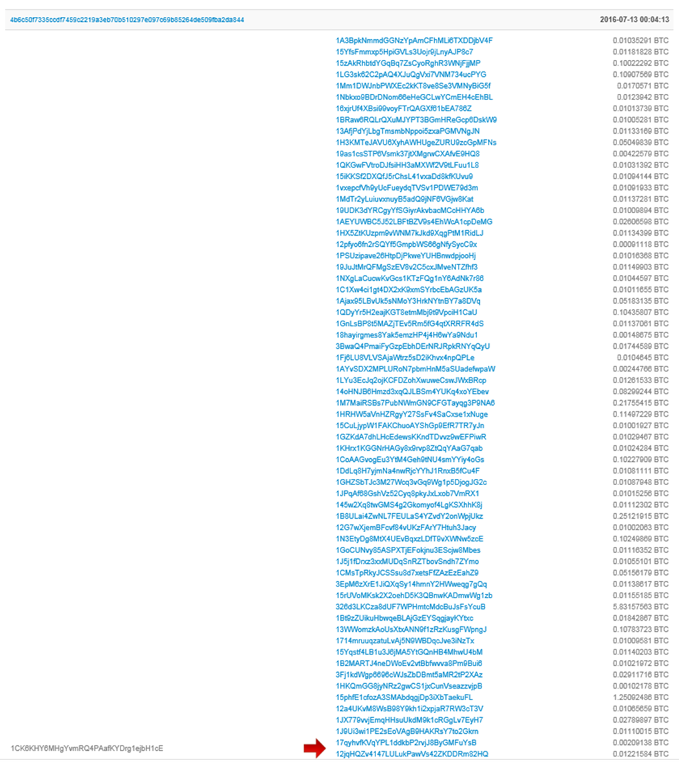
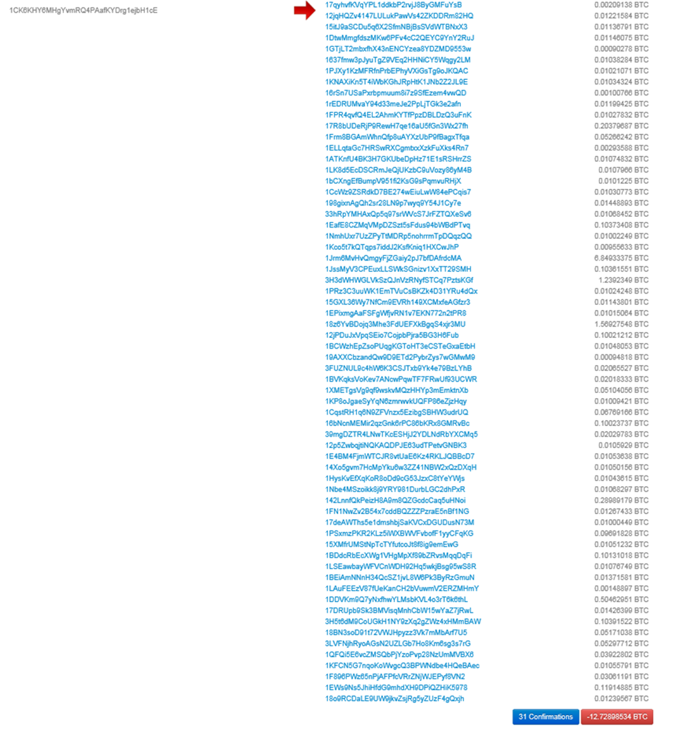
72

Slide 73


Slide 74

Bitcoin Mining Machines

Slide 75
大綱
金融科技
密碼元件
運作原理
重點新聞
應用與演進

Slide 76
Brief History of Bitcoin
1982 David Chaum 以密碼學為基礎，最早提出「不可追蹤 的支付系統」
1998 Nick Szabo 發明 “Bit gold”；使用者透過競爭，解決 「工作量證明問題」，將解答以密碼演算法串聯公布
2008 中本聰 (Satoshi Nakamoto) 在一個密碼學網站郵件 群組發表論文，描述 Bitcoin 電子現金系統
2009.1.3 中本聰公開 Bitcoin 程式碼，並發行最早的 bitcoin
2010 出現最早交易︰以 10000 bitcoins 購買 25 美元披薩
1 bitcoin = 100 bitcent = 10³ mBTC = 10⁶ μBTC = 10⁸ satoshi
2012.10 BitPay 公司表示︰超過 1000 家商店透過其支付 系統, 接收比特幣的付款

Slide 77
Brief History of Bitcoin
2013. 8. 8 Bitcoin 受美國德州聯邦法官 Hirsh 裁定為合法貨幣，
受《聯邦證券法》監管
2013. 8.19 德國政府認可 Bitcoin 法律和稅收地位，成為全世界
第一個正式認定 Bitcoin 合法的國家
2013.10.29 首台 Bitcoin 自動提款機於加拿大溫哥華啟用
2013.11.17 Mt. Gox 交易價格為 1 bitcoin = US$1216.73
2013.11.20 美國聯準會主席柏南克 (Ben Bernanke)︰如同任何線上支付
系統，Bitcoin 及其他虛擬貨幣「可能擁有長期前途」，有朝一日或許
能「促進一個更快的、更安全的、以及更有效率的支付系統形成」
2013.11.21 中央銀行總裁彭淮南︰比特幣可視為一種貴金屬
2013.12. 5 中國人民銀行發表聲明，要求各金融機構和支付機構不得
以比特幣為產品定價，不得直接或間接為客戶提供與比特幣相關服務

Slide 78


Slide 79


Slide 80





Slide 81


https://www.cryptocoinsnews.com/satoshi-nakamoto-not-eligible-nobel-prize

Slide 82

http://www.ithome.com.tw/news/105677

Slide 83


http://www.ithome.com.tw/news/105687
http://www.ithome.com.tw/news/105769

Slide 84


Slide 85


Slide 86
大綱
金融科技
密碼元件
運作原理
重點新聞
應用與演進

Slide 87
區塊鏈特色
去中心化 (decentralized)
共同維護公開帳本 (public ledger)
防止抹滅或竄改 (tamper resistant)
具備時戳 (timestamps)
自動解決交易衝突 (conflict resolution)

Slide 88
區塊鏈應用領域
銀行
支付與轉帳
網路安全
學術驗證
投票
汽車租賃與銷售
物聯網
智慧合約
分析與預測
線上音樂
出行共享
證券交易
醫療
公證
……
(族繁不及備載)
http://www.bnext.com.tw/ext_rss/view/id/1336998
http://tech.gmw.cn/2016-02/16/content_18893346.htm

Slide 89

Sidechain 側鏈
Two-way Peg: 雙向錨定

Slide 90

區塊鏈分類

Slide 91

區塊鏈分類
金融科技發展策略白皮書 p.94

Slide 92

區塊鏈分類
金融科技發展策略白皮書 p.94

Slide 93

區塊鏈分類

Slide 94

Ethereum 以太坊
Ethereum is a public blockchain platform with programmable transaction functionality
It provides a decentralized virtual machine that can execute peer-to-peer contracts using a crypto asset called Ether (unofficial code ETH)
https://www.ethereum.org

Slide 95

Vitalik Buterin
Ethereum was initially proposed by Vitalik Buterin in late 2013, and the genesis block, marking the live release of the Ethereum project, occurred on 30 July 2015
Born | January 31, 1994 Moscow, Russia
Residence | Switzerland
Citizenship | Russia, Canada
Fields | Digital contracts, Digital currencies, Game theory
Image Courtesy http://www.coinfox.info/news/video/5460-vitalik-buterin-o-blokchejne-i-nadezhnosti-ethereum-2

Slide 96
Smart Contract 智慧合約
“A computer program that directly controls digital assets”
Ethereum: Platform Review by Vitalik Buterin
Example
if HAS_EVENT_X_HAPPENED() is true:
send(party_A, 1000)
else:
send(party_B, 1000)

Slide 97

https://etherchain.org

Slide 98

http://coinmarketcap.com

Slide 99


Slide 100

http://zerocash-project.org/index.html

Slide 101

https://z.cash

Slide 102

http://technews.tw/2016/11/01/zcash

Slide 103

MaiCoin
https://www.maicoin.com

Slide 104



http://money.udn.com/money/story/5613/2054571
http://www.chinatimes.com/realtimenews/20161028004632-260410

Slide 105

http://am.is

Slide 106


http://www.ithome.com.tw/news/109416

Slide 107

http://money.udn.com/money/story/5613/2043083

Slide 108

Thank You!
Image Courtesy https://www.ethereum.org/ether

